Slide 1

Problem
Smart wear is too small to view detail information
Not everyone has smart wear.
Price of android wear is not cheap.

Slide 2


Solution
Provide notify by sound function.
Street Router

Slide 3

Architecture

Slide 4
Architecture
Create list of stings from list of step
Press
download button

Slide 5
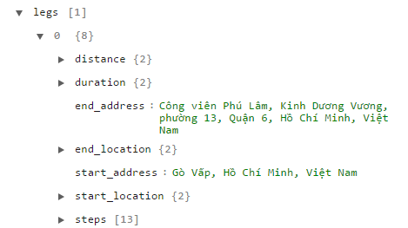
Architecture
List of steps

Slide 6
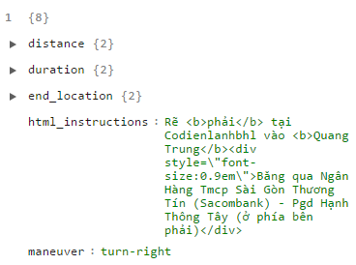
Architecture
Rẽ <b>phải</b> tại Codienlanhbhl vào <b>Quang Trung</b><div style=\"font-size:0.9em\">Băng qua Ngân Hàng Tmcp Sài Gòn Thương Tín (Sacombank) - Pgd Hạnh Thông Tây (ở phía bên phải)</div>

Slide 7
Architecture
Architecture
Rẽ <b>phải</b> tại Codienlanhbhl vào <b>Quang Trung</b><div style=\"font-size:0.9em\">Băng qua Ngân Hàng Tmcp Sài Gòn Thương Tín (Sacombank) - Pgd Hạnh Thông Tây (ở phía bên phải)</div>
Rẽ phải tại Codienlanhbhl vào Quang Trung Băng qua Ngân Hàng Tmcp Sài Gòn Thương Tín (Sacombank) - Pgd Hạnh Thông Tây (ở phía bên phải)

Slide 8
List of steps
List of strings

Slide 9

Architecture
Create list of stings from list of step
Download button
Send request
http://118.69.135.22/synthesis/file?voiceType=female&text=String

Slide 10

Architecture
Create list of stings from list of step
Download button
Send request
Return
Return list of audio files

Slide 11

Architecture
Create list of stings from list of step
Download button
Send request
Return
Save
Audio -> byte[]
List of audio files
Cache(100mb)

Slide 12
Architecture
Create list of stings from list of step
Download button
Send request
Return
Get audio file
Save
Audio -> byte[]
Street Router
List of audio files
Cache(100mb)

Slide 13
DEMO
Download audio files to mobile device
Start tracking and notify
At each turn will have sound notify

